Slide 1
Chapter 20: Securing DMVPN Tunnels
Instructor Materials
CCNP Enterprise: Advanced Routing

Slide 2
Chapter 20 Content
This chapter covers the following content:
Elements of Secure Transport - This section explains the need for data integrity, data confidentiality, and data availability.
IPsec Fundamentals - This section explains the core concepts involved with IP security encryption.
IPsec Tunnel Protection - This section explains how IPsec protection integrates with DMVPN tunnels.
Notes:
10 – Basic Router Configuration
10.1 – Configure Initial Router Settings
10.1.4 – Packet Tracer – Configure Initial Router Settings

Slide 3
Elements of Secure Transport
A properly designed network provides data confidentiality, integrity, and availability.
Without these components, a business might lose potential customers if the customers do not think that their information is secure.

Slide 4
Elements of Secure Transport Data Terms
Data confidentiality - Ensuring that data is viewable only by authorized users. Data confidentiality is maintained through encryption.
Data integrity - Ensuring that data is modified only by authorized users. Information is valuable only if it is accurate. Inaccurate data can result in an unanticipated cost. Data integrity is maintained by using an encrypted digital signature, which is typically a checksum.
Data availability - Ensuring that the network is always available allows for the secure transport of the data. Redundancy and proper design ensure data availability. encryption.
Data confidentiality: Ensuring that data is viewable only by authorized users. Data confidentiality is maintained through encryption.

Slide 5
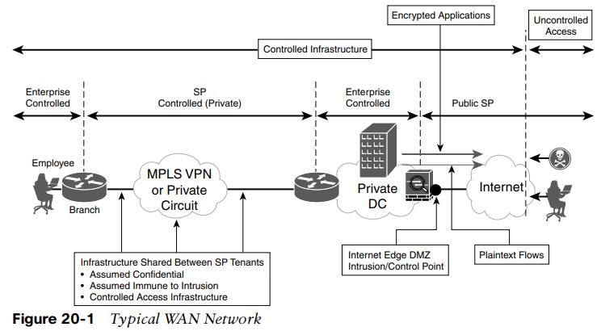
Elements of Secure Transport Typical WAN Network
Figure 20-1 shows the traditional approach to securing data on a network. The entire controlled infrastructure (enterprise and SP) is assumed to be safe. Traffic is encrypted only when exposed to the public internet.

Slide 6
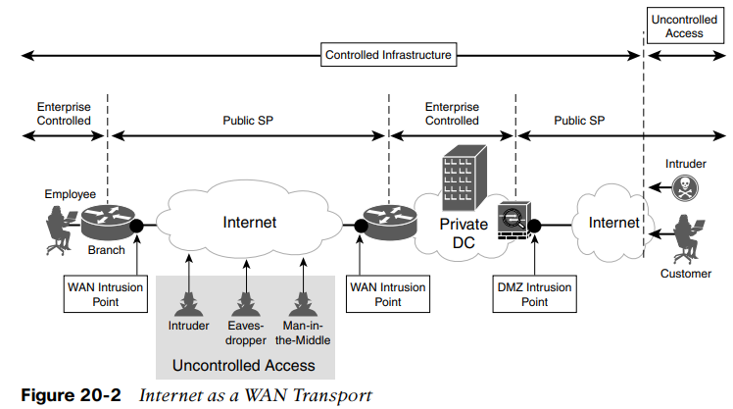
Elements of Secure Transport Internet as a WAN Transport
In Figure 20-2, the internet is used as the transport for the WAN. The internet does not provide controlled access and cannot guarantee data integrity or data confidentiality.
Data confidentiality and integrity are maintained by adding IPsec encryption to the DMVPN tunnel that uses the internet as a transport. IPsec is a set of industry standards defined in RFC 2401 to secure IP-based network traffic.

Slide 7
IPsec Fundamentals
DMVPN tunnels are not encrypted by default, but they can be encrypted by using IPsec.
IPsec provides encryption through cryptographically based security.
The IPsec security architecture is composed of the following independent components: security protocols, security associations, and key management.

Slide 8
IPsec Fundamentals IPsec with DMVPN Tunnels
When IPsec is integrated with DMVPN tunnels, the encrypted DMVPN tunnels provide a secure overlay network over any transport with the following functions:
Origin authentication - Authentication of origin is accomplished by Pre-Shared Key (static) or through certificate-based authentication (dynamic).
Data confidentiality - Ensuring that data is viewable only by authorized users. Data confidentiality is maintained through encryption. A variety of encryption algorithms are used to preserve confidentiality.
Data integrity - Hashing algorithms ensure that packets are not modified in transit.
Replay detection - This provides protection against hackers trying to capture and insert network traffic.
Periodic rekey - New security keys are created between endpoints every specified time interval or within a specific volume of traffic.
Perfect forward secrecy - Each session key is derived independently of the previous key. A compromise of one key does not mean compromise of future keys.

Slide 9
IPsec Fundamentals Security Protocols
IPsec uses two protocols to provide data integrity and confidentiality. The protocols can be
applied individually or combined based on need.
Authentication Header - The IP authentication header provides data integrity, authentication, and protection from hackers replaying packets. It uses protocol number 51 (located in the IP header) to create a digital signature to ensure that the packet has not been modified during transport.
Encapsulating Security Payload (ESP) - The Encapsulating Security Payload (ESP) provides data confidentiality, authentication, and protection from hackers replaying packets. Typically, payload refers to the actual data minus any headers, but in the context of ESP, the payload is the portion of the original packet that is encapsulated in the IPsec headers. ESP uses the protocol number 50 located in the IP header.

Slide 10
IPsec Fundamentals Key Management and Security Associations
Key Management – Part of secure encryption is communicating the keys used to encrypt and decrypt traffic that is being transported over the insecure network. The process of generating, distributing, and storing these keys is called key management. IPSec uses Internet Key Exchange (IKE) protocol by default. IKEv2 provides mutual authentication of each party. IKEv2 introduced support of Extensible Authentication Protocol (EAP) (certificate-based authentication), reduction of bandwidth consumption, Network Address Translation (NAT), and the ability to detect whether a tunnel is still alive.
Security Associations (SAs) – SAs contain the security parameters that were agreed upon between the two endpoint devices. There are two types of SAs:
IKE SA - Used for control plane functions like IPsec key management and management of IPsec SAs. Can have one IKE SA between endpoints.
IPsec SA - Used for data plane functions to secure data transmitted between two different sites. IPsec SAs are unidirectional. They require one inbound and one outbound to exchange network traffic between two sites.

Slide 11
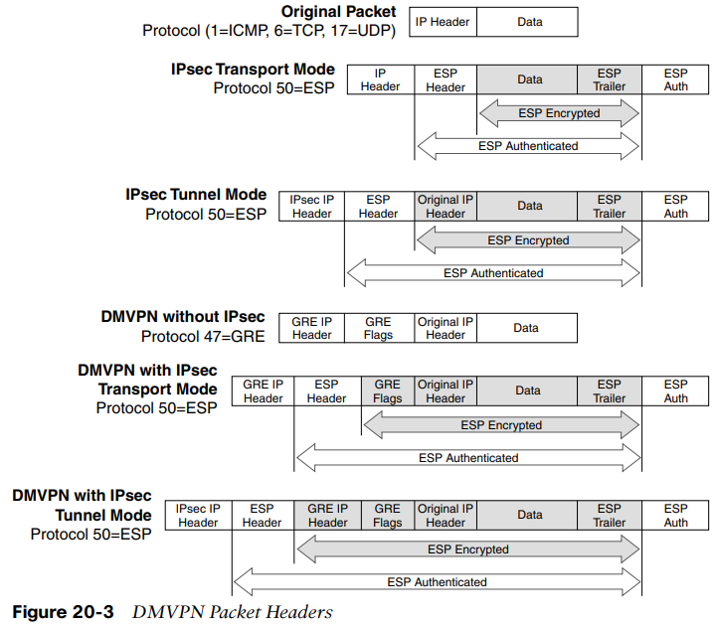
IPsec Fundamentals DMVPN Packet Headers
ESP Modes - Traditional IPsec provides two ESP modes of packet protection:
Tunnel Mode – Encrypts the entire original packet and adds a new set of IPsec headers. These new headers are used to route the packet and also to provide overlay functions.
Transport Mode – Encrypts and authenticates only the packet payload. This mode does not provide overlay functions and routes based on the original IP headers.
Figure 20-3 shows an original packet, an IPsec packet in transport mode, and an IPsec packet in tunnel mode.

Slide 12
IPsec Fundamentals ESP Modes
DMVPN Without IPsec - In unencrypted DMVPN packets, the original packets have GRE flags added to them. Then the new GRE IP header is added for routing the packets on the transport (underlay) network. The GRE IP header adds an extra 20 bytes of overhead, and the GRE flags add an extra 4 bytes. These packets use the protocol field of GRE (47).
DMVPN with IPsec in Transport Mode - For encrypted DMVPN packets that use ESP transport mode, the original packets have the GRE flags added, then that portion of the packets is encrypted. A signature for the encrypted payload is added, and then a GRE IP header is added for routing the packets on the transport network. The GRE IP header adds an extra 20 bytes of overhead, the GRE flags add an extra 4 bytes, and depending on the encryption mechanism, a varying number of bytes are added for the encrypted signature. These packets use the protocol field of ESP (50).
DMVPN with IPsec in Tunnel Mode - For encrypted DMVPN packets that use ESP tunnel mode, the original packets have GRE flags added to them, and then a new GRE IP header is added for routing the packets on the transport network. That portion of the packets is encrypted, a signature for the encrypted payload is added, and a new IPsec IP header is added for routing the packets on the transport network. The GRE IP header adds an extra 20 bytes of overhead, the GRE flags add an extra 4 bytes, the IPsec IP header adds an extra 20 bytes, and depending on the encryption mechanism, a varying number of bytes are added for the encrypted signature. These packets use the IP protocol field of ESP (50). IPsec tunnel mode for DMVPN does not add value, transport mode should be used for encrypted DMVPN tunnels.

Slide 13
IPsec Tunnel Protection
Enabling IPsec protection on a DMVPN network requires that all devices have IPsec protection enabled.
If some routers have IPsec enabled and others do not, devices with mismatched settings will not be able to establish connections on the tunnel interfaces.

Slide 14
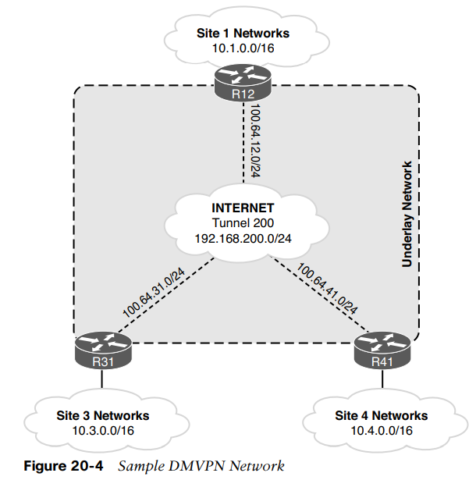
IPsec Tunnel Protection Pre-Shared Key Authentication
The first scenario for deploying IPsec tunnel protection is with the use of static Pre-Shared Key, which involves the creation of the following:
IKEv2 keyring
IKEv2 profile
IPsec transform set
IPsec profile
In this section, emphasis is on the DMVPN routers that are attached to the internet, as shown in Figure 20-4.

Slide 15
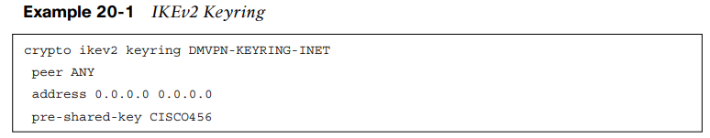
IPsec Tunnel Protection IKEv2 Keyring
The IKEv2 keyring is a repository of the pre-shared keys and is created with the following steps:
Step 1. Create the keyring with the command crypto ikev2 keyring keyring-name.
Step 2. Create the peer with the command peer peer-name. Multiple peers can exist in a keyring. Each peer has a matching qualifier and can use a different password.
Step 3. Identify the IP address so that the appropriate peer configuration is used, based on the remote device’s IP address. The command address network subnet-mask defines the IP address range.
Step 4. Define the pre-shared key with the command pre-shared-key secure-key. Generally a long and alphanumeric password is used for increased security.
Example 20-1 demonstrates a simple keyring that is used to secure the DMVPN routers on the internet.

Slide 16
IPsec Tunnel Protection IKEv2 Profile
The IKEv2 profile is a collection of nonnegotiable security parameters used during the IKE security association:
Step 1. Define the IKEv2 profile by using the command crypto ikev2 profile ike-profile-name.
Step 2. Define the peer IP address with the command match identity remote address ip-address.
Step 3. Optionally set the local router’s identity based on an IP address by using the command identity local address ip-address.
Step 4. If Front Door VRF (FVRF) is used on the DMVPN tunnel, associate the FVRF instance with the IKEv2 profile with the command match fvrf {vrf-name | any}.
Step 5. Define the authentication method for connection requests received by remote peers by using the command authentication local {pre-share | rsa-sig}. The pre-share keyword is used for static keys, and rsa-sig is used for certificate-based authentication.
Step 6. Define the authentication method for connection requests sent to remote peers by using the command authentication remote {pre-share | rsa-sig}.
Step 7. For pre-shared authentication, associate the IKEv2 keyring with the IKEv2 profile by using the command keyring local keyring-name.

Slide 17
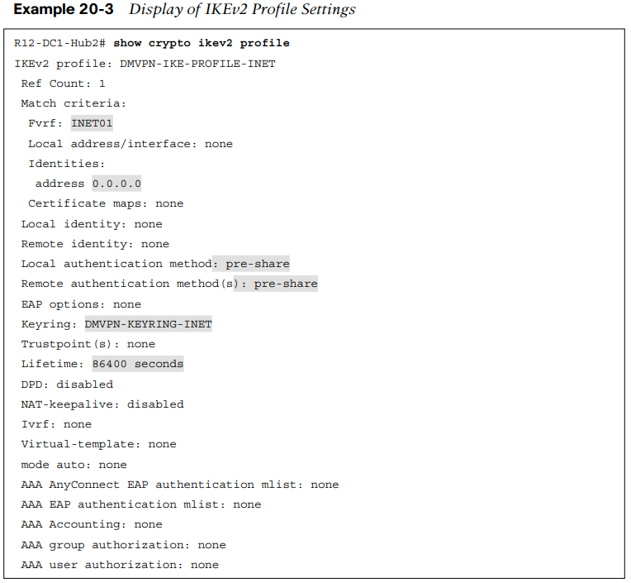
IPsec Tunnel Protection IKEv2 Profile (Cont.)
The IKEv2 profile settings are displayed with the command show crypto ikev2 profile, as shown in Example 20-3. Notice that the authentication, FVRF, IKE keyring, and identity IP address are displayed along with the IKE lifetime.

Slide 18
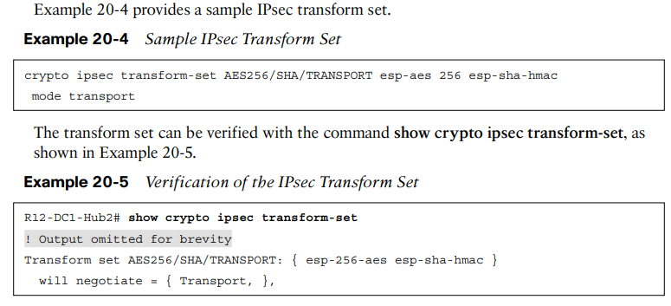
IPsec Tunnel Protection IPsec Transform Set
The transform set identifies the security protocols (such as ESP) for encrypting traffic. It specifies the protocol ESP or authentication header that is used to authenticate the data:
Step 1. Create the transform set and identify the transforms by using the command crypto ipsec transform-set transform-set-name [esp-encryption-name] [esp-authentication-name] [ah-authentication-name].
Step 2. Configure the ESP mode by using the command mode {transport | tunnel}.

Slide 19
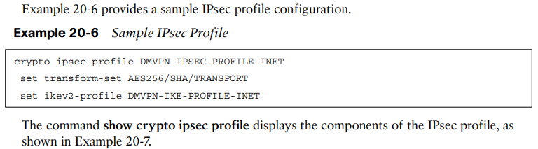
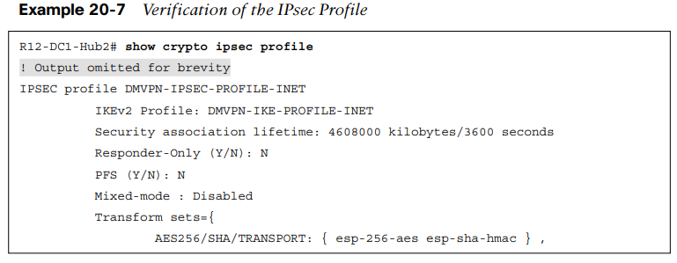
IPsec Tunnel Protection IPsec Profile
The IPsec profile combines the IPsec transform set and the IKEv2 profile:
Step 1. Create the IPsec profile by using the command crypto ipsec profile profile-name.
Step 2. Specify the transform set by using the command set transform-set transform-set-name.
Step 3. Specify the IKEv2 profile by using the command set ikev2-profile ike-profile-name.

Slide 20
IPsec Tunnel Protection Encrypt the Tunnel Interface/IPsec Packet Replay Protection
When all the required IPsec components have been configured, the IPsec profile is associated to the DMVPN tunnel interface with the command tunnel protection ipsec profile profile-name [shared]. The shared keyword is required for routers that terminate multiple encrypted DMVPN tunnels on the same transport interface. The command shares the IPsec security association database (SADB) among multiple DMVPN tunnels.
Cisco IPsec includes an anti-replay mechanism that prevents intruders from duplicating encrypted packets. A unique sequence number is assigned to each encrypted packet. When a router decrypts the IPsec packets, it keeps track of the packets it has received. The IPsec anti-replay service rejects (discards) duplicate packets or old packets. The router maintains a sequence number window size (default of 64 packets). The minimum sequence number is the highest sequence number for a packet minus the window size. A packet is considered of age when the sequence number is between the minimum sequence number and the highest sequence number.
The window size is increased globally with the command crypto ipsec security-association replay window-size window-size. Cisco recommends using the largest window size possible for the platform, which is 1024.

Slide 21
IPsec Tunnel Protection Dead Peer Detection/NAT Keepalives
Dead Peer Detection (DPD) helps detect the loss of connectivity to a remote IPsec peer. When DPD is enabled in on-demand mode, the two routers check for connectivity only when traffic needs to be sent to the IPsec peer and the peer’s active status is not certain. The router sends a DPD R-U-THERE request to query the status of the remote peer. If the remote router does not respond to the R-U-THERE request, the requesting router starts to transmit additional R-U-THERE messages every retry interval for a maximum of five retries. After that, the peer is declared dead. DPD is configured with the command crypto ikev2 dpd [interval-time] [retry-time] on-demand in the IKEv2 profile.
NAT keepalives keep the dynamic NAT mapping alive during a connection between two peers. A NAT keepalive is a UDP packet that contains an unencrypted payload of 1 byte. When DPD is used to detect peer status, NAT keepalives are sent if the IPsec entity has not transmitted or received a packet within a specified time period. NAT keepalives are enabled with the command crypto isakmp nat keepalive seconds.

Slide 22
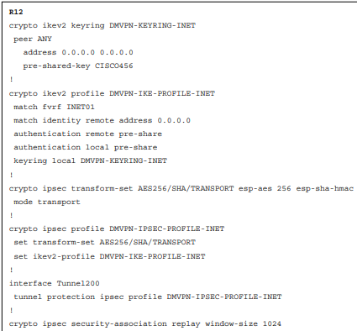
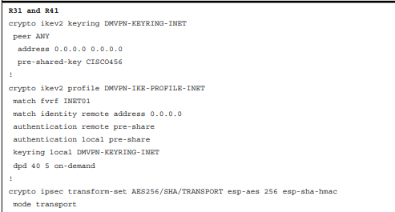
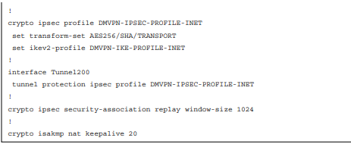
IPsec Tunnel Protection IPsec DMVPN Configuration with Pre-Shared Authentication
Example 20-9 displays the complete configuration to enable IPsec protection on the internet
DMVPN tunnel on R12, R31, and R41 with all the settings from this section.

Slide 23
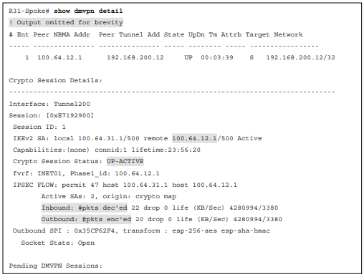
IPsec Tunnel Protection Verification of Encryption on DMVPN Tunnels
When the DMVPN tunnels have been configured for IPsec protection, verify the status. The command show dmvpn detail provides the relevant IPsec information. Example 20-10 demonstrates the command on R31. The output lists the status of the DMVPN tunnel, the underlay IP addresses, and packet counts. Examining the packet counts can help to verify that network traffic is being transmitted out of a DMVPN tunnel or received on a DMVPN tunnel.
The command show crypto ipsec sa provides additional information that is not included in the output of the command show dmvpn detail, such as the path MTU, tunnel mode and replay detection.

Slide 24
IPsec Tunnel Protection IKEv2 Protection
IKEv2 was developed, in part, to protect routers from various IKE intrusion methods. Primarily, it limits the number of packets required to process IKE establishment. During high CPU utilization, a session that has started may not complete because other sessions are consuming limited CPU resources. Problems can occur when the number of expected sessions is different from the number of sessions that can be established. Limiting the number of sessions that can be in negotiation minimizes the CPU resources needed so that the expected number of established sessions can be obtained.
The command crypto ikev2 limit {max-in-negotiation-sa limit | max-sa limit} [outgoing] limits the number of sessions being established or that are allowed to be established:
The max-sa keyword limits the total count of SAs that a router can establish under normal conditions. You set the value to double the number of ongoing sessions in order to achieve renegotiation.
To limit the number of SAs being negotiated at one time, you can use the max-in-negotiation-sa keyword.
To protect IKE from half-open sessions, a cookie can be used to validate that sessions are valid IKEv2 sessions and not denial-of-service intrusions. The command crypto ikev2 cookie-challenge challenge-number defines the threshold of half-open SAs before issuing an IKEv2 cookie challenge.

Slide 25
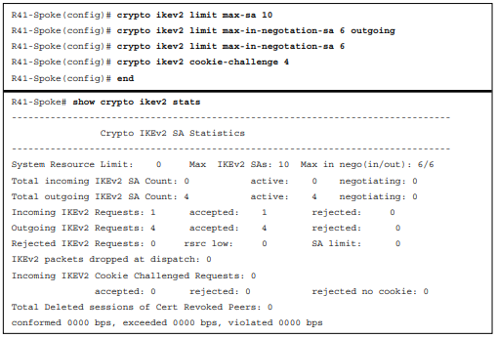
IPsec Tunnel Protection IKEv2 Protection (Cont.)
In Example 20-12, R41 limits the number of SAs to 10, limits the number in negotiation to 6, and sets an IKEv2 cookie challenge for sessions above 4. R41 has 1 static session to the hub router (R11) and is limited to 9 additional sessions that all use the IKEv2 cookie challenge.
The command show crypto ikev2 stats displays the SA restrictions and shows that the four sessions are currently established to the four DMVPN hub routers.

Slide 26
Prepare for the Exam

Slide 27
Prepare for the Exam Key Topics for Chapter 20
Description
Data security terms | IPsec transform set
Security associations | Encrypting the tunnel interface
ESP modes | IPsec packet replay protection
IKEv2 keyring | Verification of encryption on DMVPN tunnels
IKEv2 profile | IKEv2 protection

Slide 28
Prepare for the Exam Key Terms for Chapter 20
Key Terms
Authentication Header (AH) protocol
Encapsulating Security Payload (ESP)
Data confidentiality
Data integrity
Data availability
Origin authentication
Replay detection
Periodic rekey
Security association (SA)

Slide 29
Prepare for the Exam Command Reference for Chapter 20
Task | Command Syntax
Configure an IKEv2 keyring | crypto ikev2 keyring keyring-name peer peer-name address network subnet-mask pre-shared-key secure-key
Configure an IKEv2 profile | crypto ikev2 profile ike-profile-name match identity remote address ip-address match fvrf {vrf-name | any} authentication local pre-share authentication remote pre-share keyring local keyring-name
Configure an IPsec transform set | crypto ipsec transform-set transform-set-name [esp-encryption-name] [esp-authentication-name] [ah-authentication-name] mode {transport | tunnel}

Slide 30
Prepare for the Exam Command Reference for Chapter 20 (Cont.)
Task | Command Syntax
Configure an IPsec profile | crypto ipsec profile profile-name set transform-set transform-set-name set ikev2-profile ike-profile-name
Encrypt the DMVPN tunnel interface | tunnel protection ipsec profile profile-name [shared]
Modify the default IPsec replay window size | crypto ipsec security-association replay window-size window-size
Enable IPsec NAT keepalives | crypto isakmp nat keepalive seconds
Display the IKEv2 profile | show crypto ikev2 profile
Display the IPsec profile | show crypto ipsec profile

